Slide 1
Unstructured Data or: How I Learnt To Stop Worrying And Love /regex/
Luke Keating Hughes 09/08/2019

Slide 2




My experience going in
How naivety helped me choose a great project
Notes:
I’d only just learnt SQL
I didn’t know any python
I had never used a database with more than 5,000 rows

Slide 3


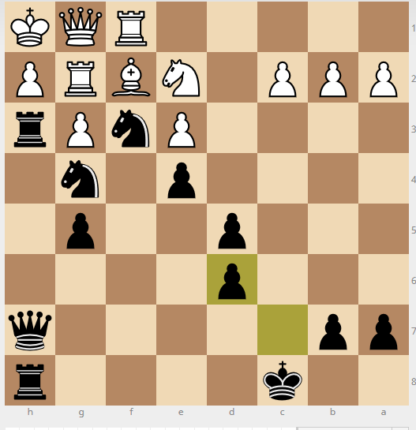
(Li)chess
A brief history
Notes:
Lichess, created by Thibault Duplessis in 2010, is completely open source.
Lichess has over 740 million chess games stored as 1TB of plain text files.
They are essentially stored as logs, each game getting appended onto the last.
The data is unstructured and is stored in a format called ‘pgn’ or portable game notation.
I decided to analyse the data from November 2018 with is a single 50GB text file.

Slide 4
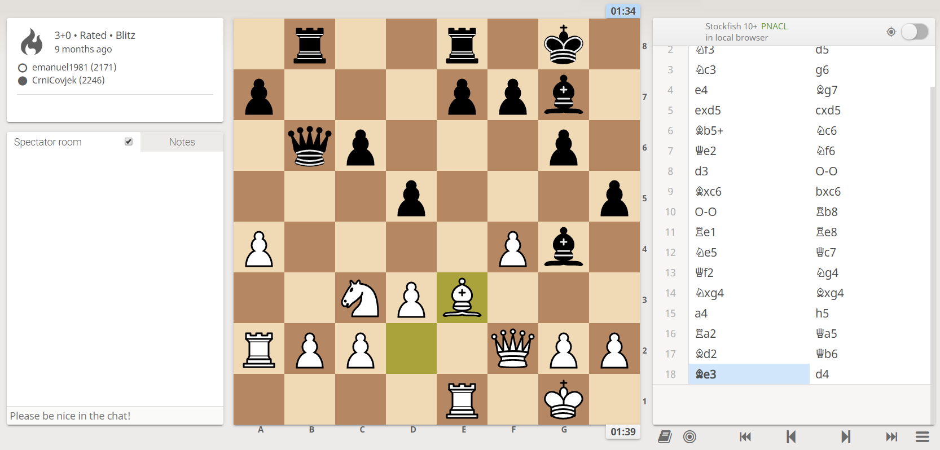
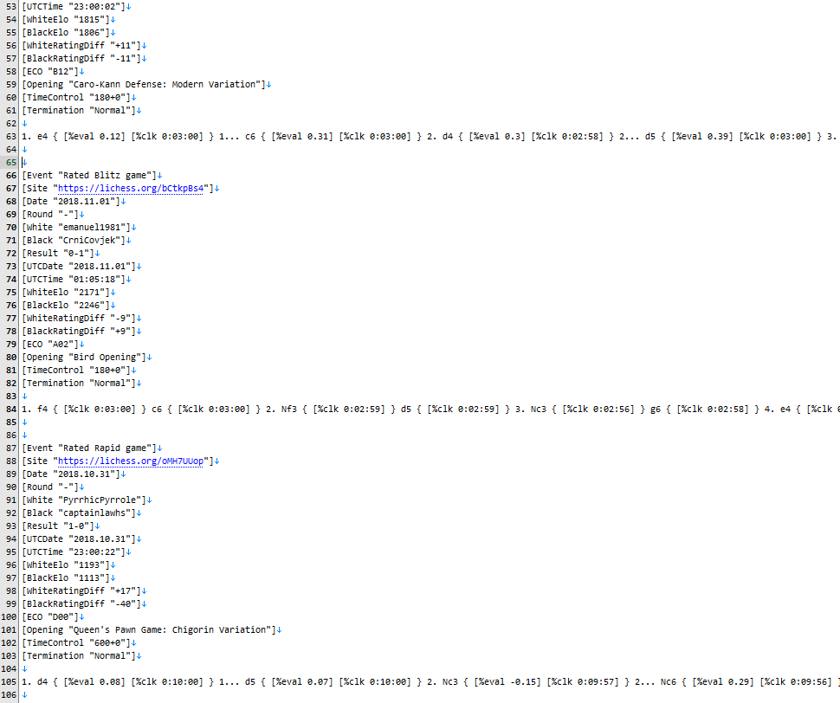
PGN
No, they aren’t pictures
Notes:
Description of pgn and lichess data
Description of how unstructured the data is
- varying headers
- different game notation (i.e. comments, numbering of moves)
- different types of games
I should have heeded Sam’s warning…
Why I chose the data
- challenging
- teach me skills relevant to starting at DHS
- The chess data had perfect integrity. I knew any mistakes I made were mine which is better than most data.

Slide 5
PGN
A standardised notation without structure
[header1: “data”]
[header2: “more data”]
…
1. e4 e5 2. Nf3 Nc6 3…
Notes:
Here is an example of

Slide 6
Hey now, you’re an all Star (Schema)
A standardised notation without structure
[header1: “data”]
[header2: “more data”]
…
1. e4 e5 2. Nf3 Nc6 3…
[header2: “data”]
[header1: “more data”]
…
1. e4 {[%clk = 1:00] [%eval = +0.2]} 1… a1? {[%clk = 0:56] [%eval = +1.2]} 2. …
Notes:
I had to set design considerations from really early in the project. I opted to create a 3NF compliant database with two tables:
- one with all the metadata for each game
- one with all the move data for each game (move no, move, time, eval)
This was a risk and it would have been really hard to go back and change this structure
One regret was creating an index number when there was a perfectly good index in the data already.

Slide 7



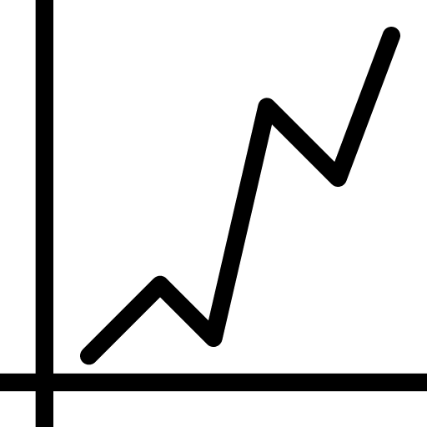

Scope and hypothesis
Following in the footsteps of David Hilbert
?
Notes:
Luckily I had 3 really smart people on the bench with heaps of experience in all of these things: - Sam: PhD in Computer Science
- Paul: BI wiz
- Simon: Lots of industry experience in coding
They encouraged me to stop entertaining hypotheticals and just

Slide 8
Less is more
Simplifying simply simplifies

Slide 9
Hey now, you’re an all Star (Schema)
From unstructured to structure
Notes:
I had to set design considerations from really early in the project. I opted to create a 3NF compliant database with two tables:
- one with all the metadata for each game
- one with all the move data for each game (move no, move, time, eval)
This was a risk and it would have been really hard to go back and change this structure
One regret was creating an index number when there was a perfectly good index in the data already.

Slide 10
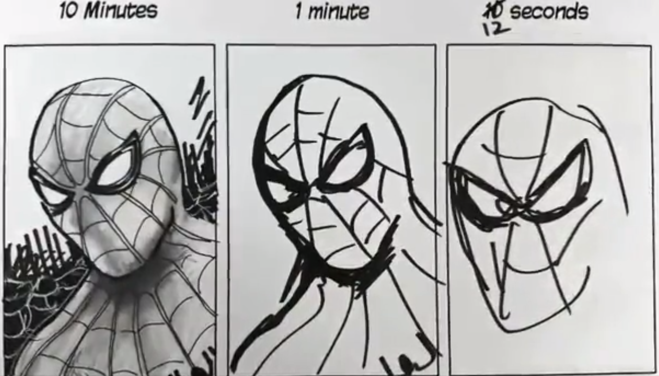
Iterating towards perfection
I’m not bad at coding, I’m agile!
Notes:
v1: Just read and printed pgn line by line, had no idea whether the headers were correct, etc, very error prone
v2: Started to be more careful, checked headers were right and discarded games that didn’t conform. Way better for pulling data out but still losing lots of games that could have been salvaged
v3: Main code just identifies blocks and passes them to functions to do all the specialized processing. Code is modular and easy to upgrade if a bug/new type of game is spotted. Functions became sophisticated enough to salvage information from games that didn’t conform to the normal structure. Began logging games that caused strange problems.
v4: No games are missed. Functions are now using chess packages to enrich the data before passing it to database (i.e. tracking locations of pieces in a third table).
Lesson learnt after working at DHS: use Git!!!

Slide 11

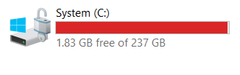
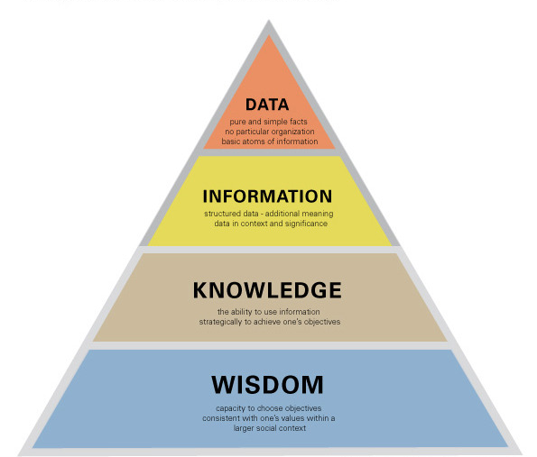


Problems at scale
and what it taught me
Notes:
Hosting a database with 800,000,000 needs more hardware, so start small. I had to work from home one Monday because I started loading records in on Sunday morning and it ran until Monday afternoon. I’m not saying any of you SHOULD do this, I’m just saying that I accidentally did this and got to work in my pyjamas…
No matter how good your code is, big data will break it (even slightly deviant chess games broke my database. Imagine trying to create a Computer vision AI that can deal with photos of documents uploaded to DHS). Every time I scaled up my dataset something new broke.
No matter how well you understand your dataset, big data will surprise you.
Data -> Information -> Knowledge -> Wisdom. I found myself getting better at chess. As I understood the dataset more and more (and created visualisations) I started to get better at finding how the data was related. By the end I could get people to ask questions they’d like to know, and I’d be able to figure it out quickly.
Ping pong

Slide 12
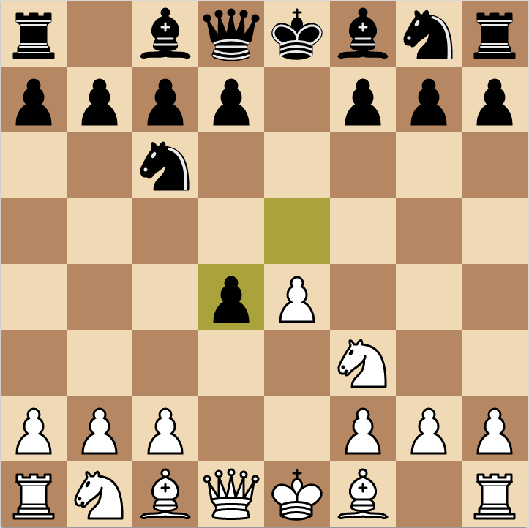
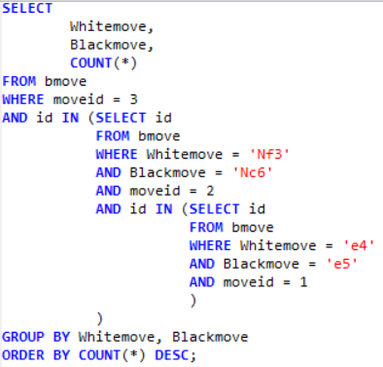
Some preliminary results
Cold…

Slide 13

White wins 51.7% of chess games

Slide 14
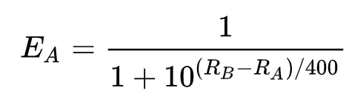
Some more advanced visualisations
…Colder…
Notes:
Explain Elo
Explain that we expect a curve that looks like

Slide 15
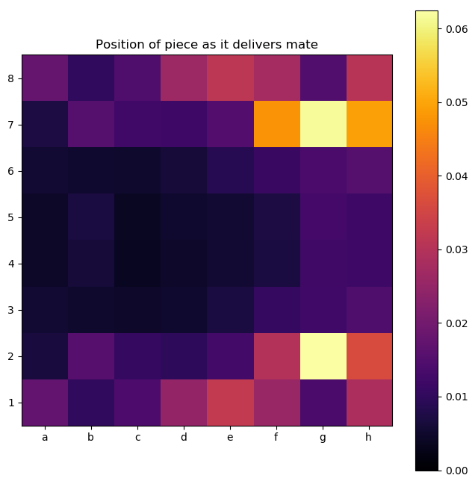
Heatmaps
…getting warmer…

Slide 16
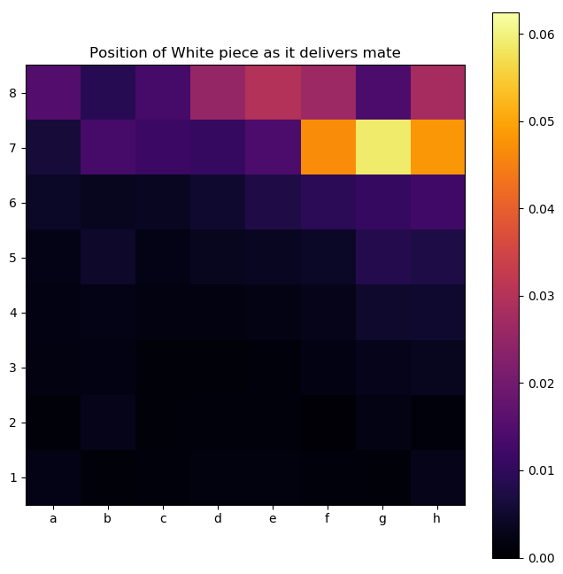
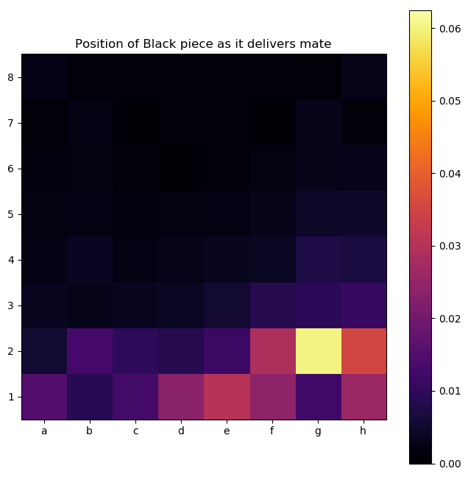
Heatmaps
…getting warmer…

Slide 17
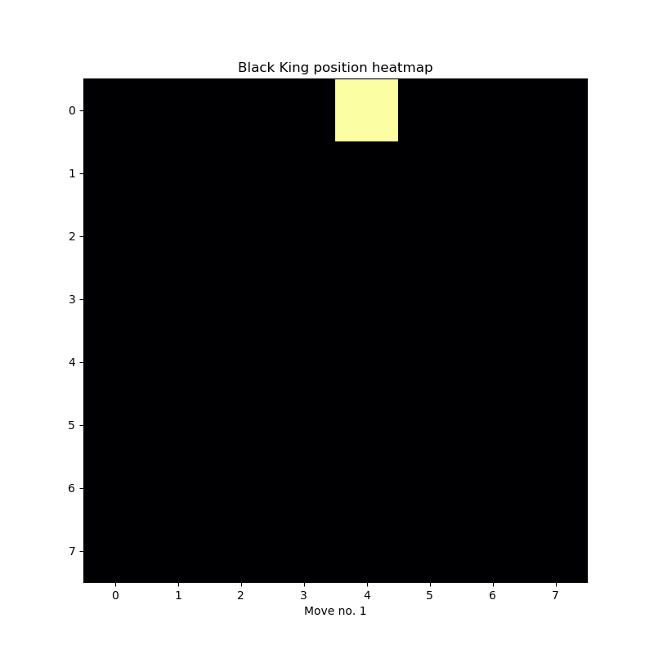
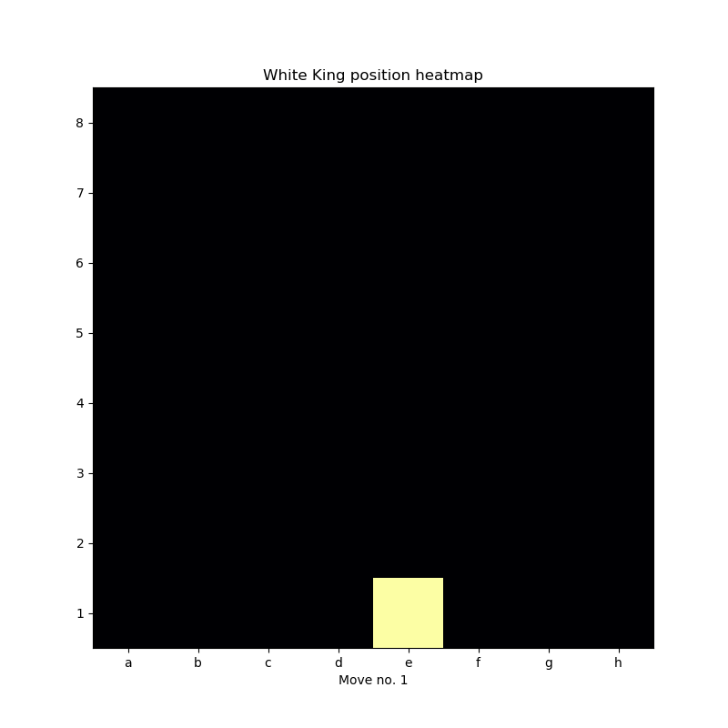
Heatmaps
Hot! Hot! Hot!

Slide 18
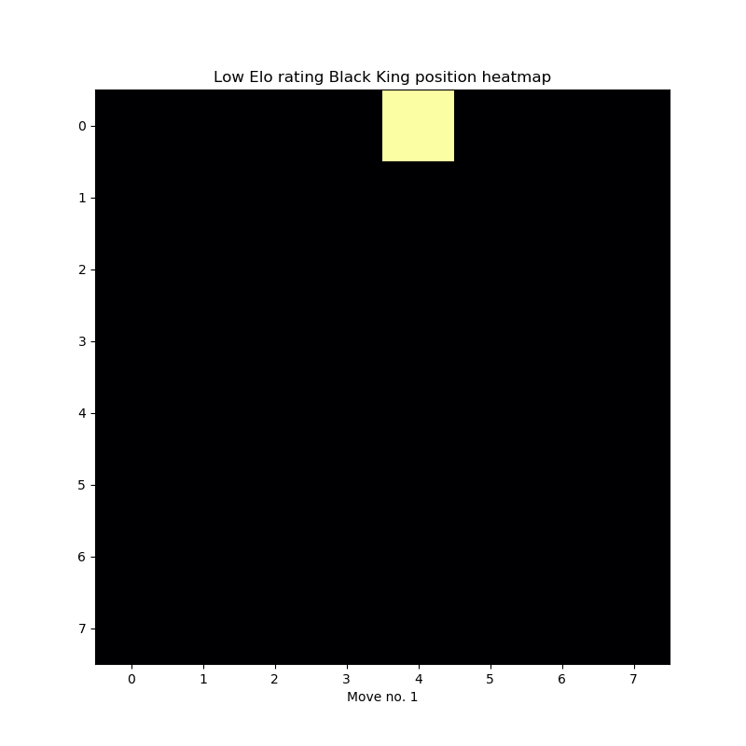

Heatmaps
Hot! Hot! Hot!

Slide 19
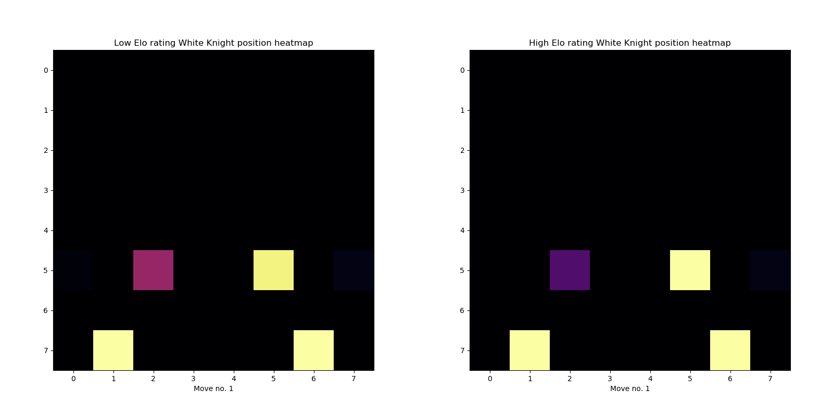
Heatmaps
Hot! Hot! Hot!

Slide 20



Future work
The never-ending project

Slide 21

Our mind is all we've got. Not that it won't lead us astray sometimes, but we still have to analyze things out within ourselves.
-- Bobby Fischer
Thank you

